Slide 1


Voice-First Multi-Agent System
for Tribal Producers
A voice-based AI platform that helps tribal producers sell their products, find buyers, and access real-time market information using their own native languages.
"Empowering tribal producers to earn more income by connecting them directly to markets through simple, natural voice conversations."

Slide 2

Problem Statement
Limited access to digital marketplaces.
Low digital literacy and technology adoption.
Language barriers in existing online platforms.
Dependence on middlemen for selling products.
Lack of information about market demand and prices.
Poor visibility of tribal products in wider markets.
Target Beneficiaries:
Tribal farmers
Forest produce collectors
Self-Help Groups (SHGs)
Tribal entrepreneurs

Slide 3
How does it work
Registration agent – helps users onboard through voice.
Product agent – assists in product listing and catalog creation.
Marketing agent – generates product descriptions and promotions.
Market intelligence agent – provides market trends and price information.
Buyer matching agent – connects producers with potential buyers.
Support agent – handles queries and assistance through voice interaction

Slide 4
How does it work
No typing. No reading. Just speak.
Register effortlessly: The AI guides users through a spoken onboarding process.
Add products: Simply describe the items to list them on the marketplace.
Find buyers: AI agents automatically match products with interested buyers.
Market intelligence: Ask for current market prices and trends instantly.
Ongoing support: Agents answer questions and provide continuous voice assistance.

Slide 5
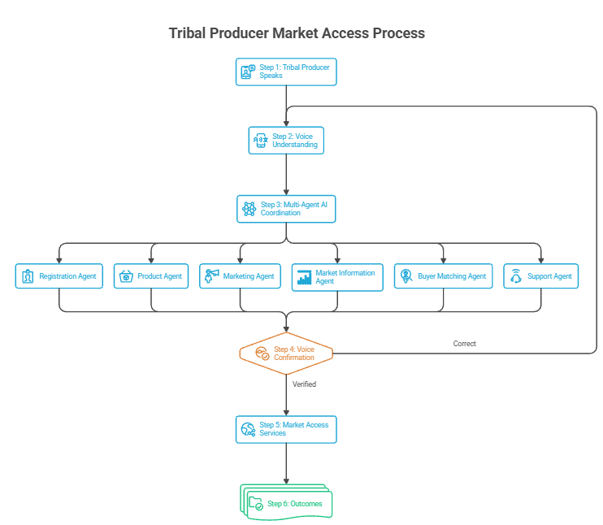

Slide 6
Technology & Innovation
Technology Used
Agentic AI and Multi-Agent Systems
Large Language Models (LLMs)
Speech Recognition (ASR)
Text-to-Speech (TTS)
Natural Language Processing (NLP)
Retrieval-Augmented Generation (RAG)
Multilingual Conversational AI
Innovation
✔ Voice-first design for low-literacy users
✔ AI agents performing specialized tasks
✔ Local language support
✔ Transparent voice confirmation before every submission
✔ Human-centered and inclusive digital commerce platform

Slide 7

Expected Impact
Improved market access for tribal producers.
Better visibility and promotion of tribal products.
Increased income and livelihood opportunities.
Reduced dependence on intermediaries.
Higher adoption of digital commerce platforms.
Strengthened tribal entrepreneurship.
The Expected Outcome
By breaking down digital and linguistic barriers, we are helping tribal producers reach more customers, earn better income, and significantly improve their economic well-being through an intuitive, simple voice-based AI system.

Slide 8
Questions?
Thank you for your time and attention.

